Slide 1

Applied Machine Learning (BUAN 6341) Principal Component Analysis

Slide 2
Agenda
Dimensionality Reduction
Principal Component Analysis
PCA Example

Slide 3
Dimensionality Reduction

Slide 4
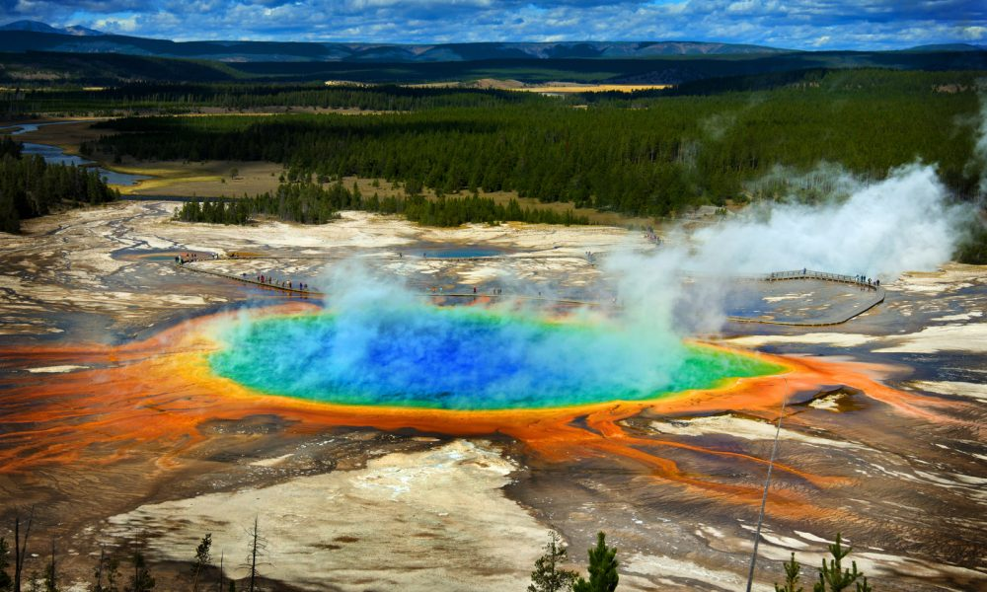

High Dimension Data
High resolution images (with millions of pixels)
News article (hundreds of thousands of words)
Customer purchase data on multiple channels

Slide 5
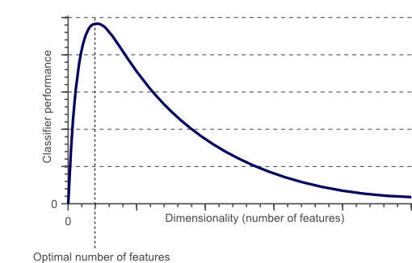
Curse of Dimensionality

Slide 6

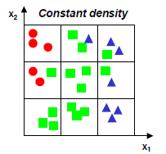
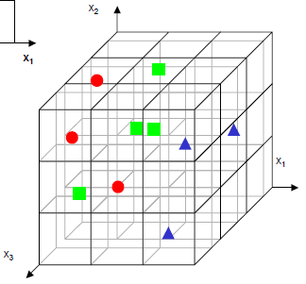
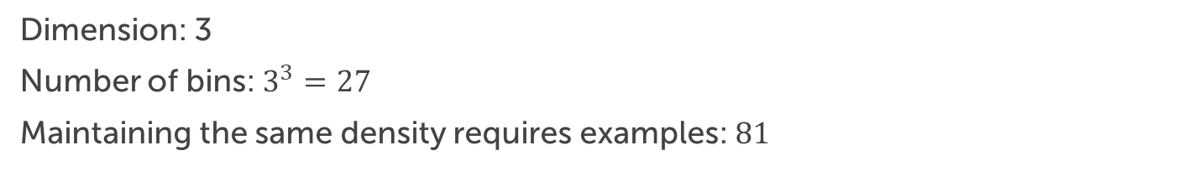
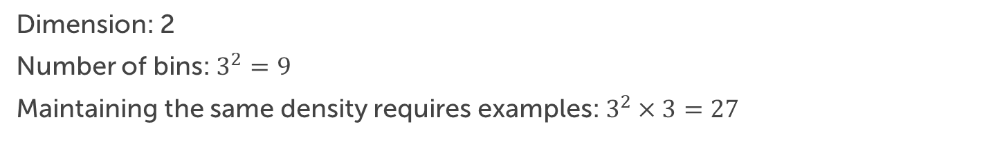
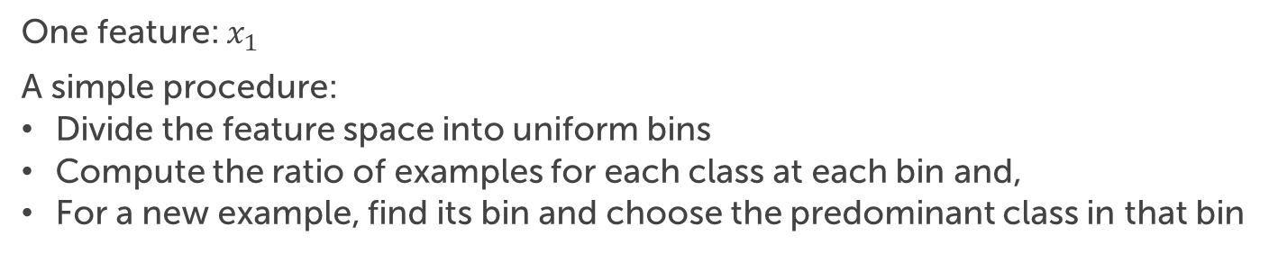
Illustration: 3-class pattern recognition
One feature: $x_{1}$
A simple procedure:
Divide the feature space into uniform bins
Compute the ratio of examples for each class at each bin and,
For a new example, find its bin and choose the predominant class in that bin
Dimension: 2
Number of bins: $3^{2}=9$
Maintaining the same density requires examples: $3^{2}×3=27$
Dimension: 3
Number of bins: $3^{3}=27$
Maintaining the same density requires examples: $81$

Slide 7
Dimensionality Reduction
Implications of the curse of dimensionality
Exponential growth with dimensionality in the number of examples required to accurately estimate a function
In practice, the curse of dimensionality means that
For a given sample size, there is a maximum number of features above which the performance of our classifier will degrade rather than improve
In most cases, the information that was lost by discarding some features is compensated by a more accurate mapping in lower-dimensional space

Slide 8
Principal Component Analysis

Slide 9
PCA Overview
PCA is a technique that can simplify data
It is a linear transformation that chooses a new coordinate system for the data set such that
greatest variance by any projection of the data set comes to lie on the first axis (then called the first principal component)
the second greatest variance on the second axis, and so on.

Slide 10
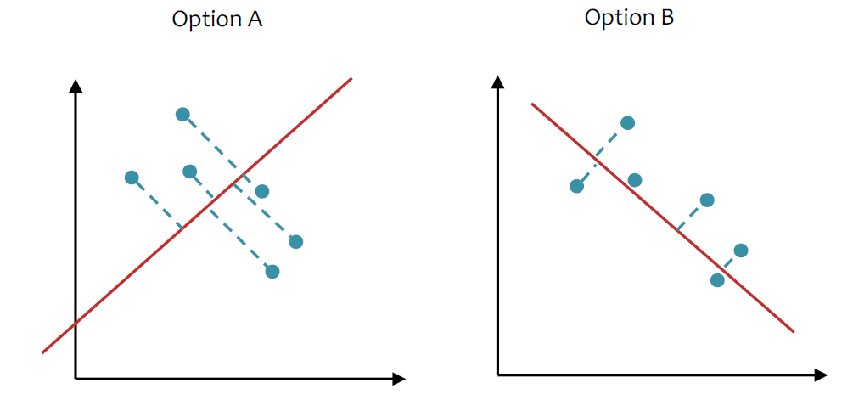
PCA: Maximize the Variance
Quiz: Consider the two projections below
1. Which maximizes the variance?
2. Which minimizes the reconstruction error?

Slide 11
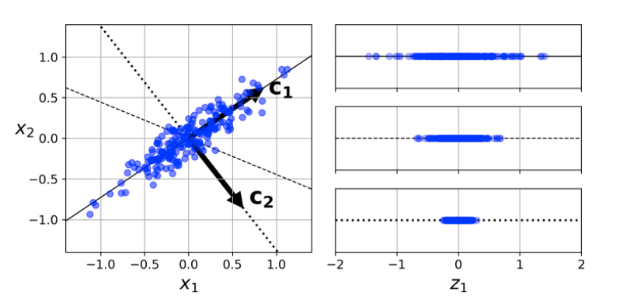
PCA: Maximize the Variance

Slide 12
2D Gaussian Dataset
The original dataset:

Slide 13
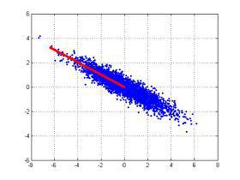
2D Gaussian Dataset
First find the direction of maximum variance, labeled “Component 1”
Along this direction:
Features are most correlated with each other
Contains the most of the information

Slide 14
2D Gaussian Dataset
Component 2: orthogonal to the first direction & maximized variance

Slide 15
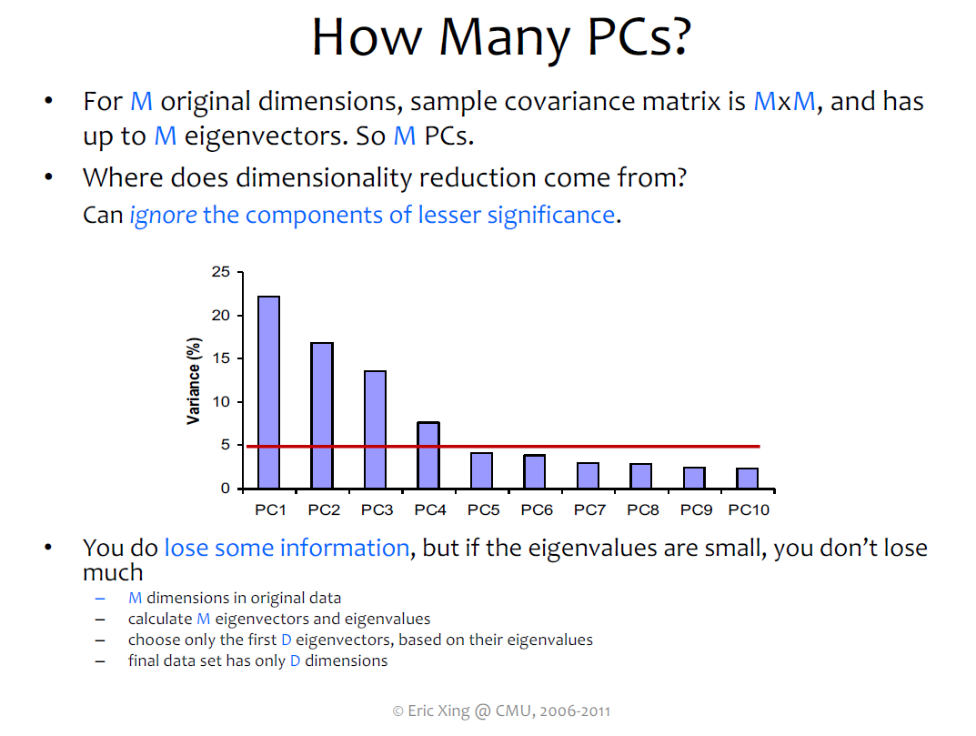

Slide 16
What Next ?
Hands on ML2 (Chapter 1 -9)
Structured Data
Time Series Analysis (Prophet Library by Facebook
Unstructured Data (Deep Learning Based Methods)
Images (DL course)
Text (NLP Course
For Job interviews:
SQL
Data Structures and Algorithms
Hypothesis Testing

